Slide 1



Mapping NeuroGraph to CWL Design Studio for fMRI Modeling
Anwar Said, Yogesh Barve, Tamas Kecskes, Xenofon Koutsoukos, and Janos Sztipanovits
Institute for Software Integrated Systems, Vanderbilt University, TN

Slide 2
Agenda
Introduction to NeuroGraph package
CWL Design Studio
Training Pipeline
CWL components
Testing Workflows
CWL Walkthrough

Slide 3
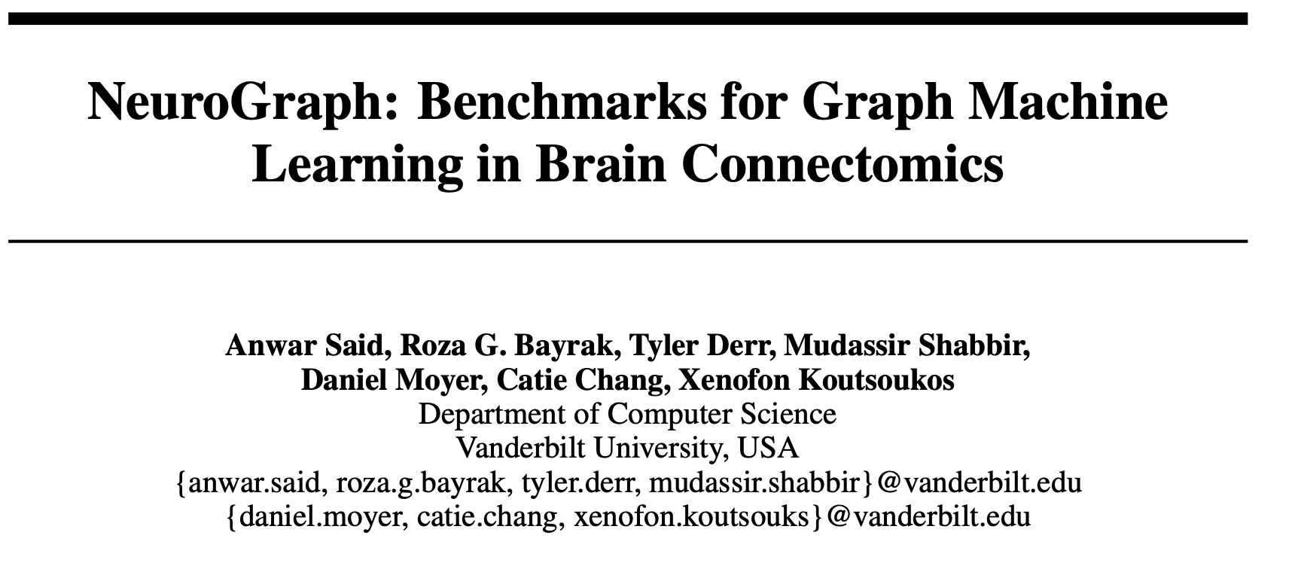
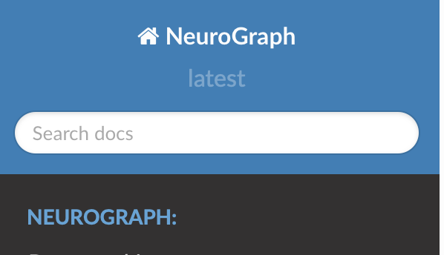
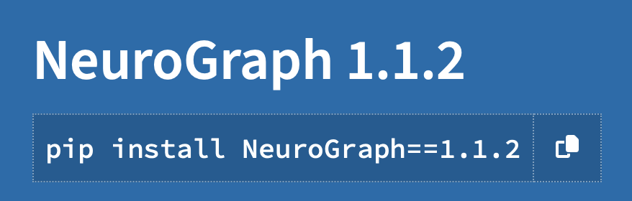

Slide 4
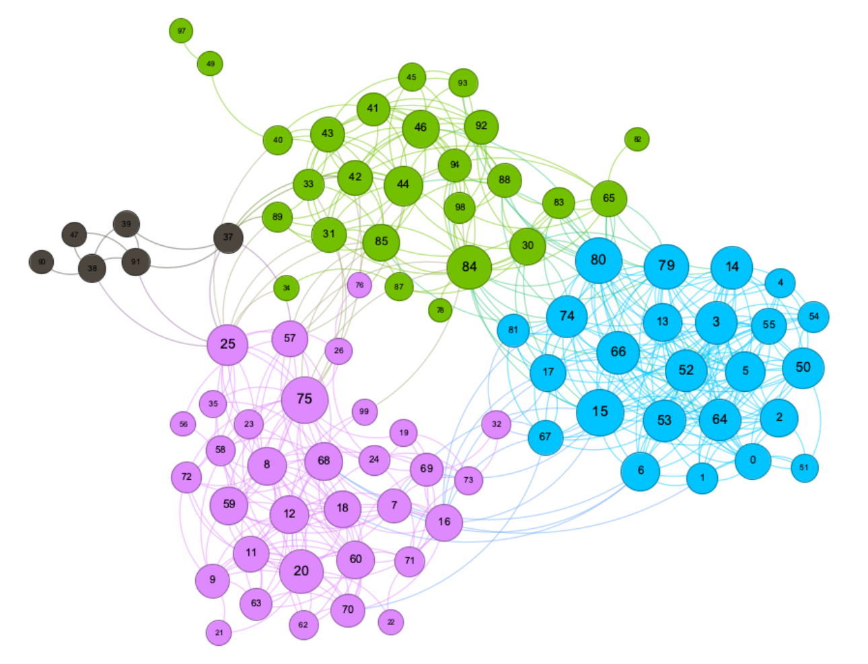
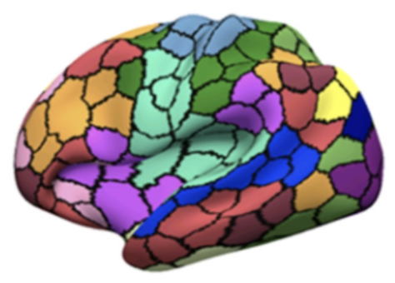
Motivation
Graph machine learning is a powerful paradigm for learning from graph-structured data
Utilizes relationships within the data compared to just the data alone to make better predictions
Applications:
Recommendation
Forecasting
Neuroimaging, and a lot more
Provides a natural way to exchange messages between highly correlated regions of interests in the brain

Slide 5
Challenges
Complex preprocessing pipelines
Requires domain knowledge
Huge parameter search space
Parcellation methods
Number of ROIs
Thresholding
Different types of graph data modalities, etc.
No available easy-to-use programming tools
NeuroGraph:
Provides tools for preprocessing fMRI data
Constructing graph-based datasets and models
Provides graph-based Neuroimaging benchmarks with a set of prediction tasks

Slide 6
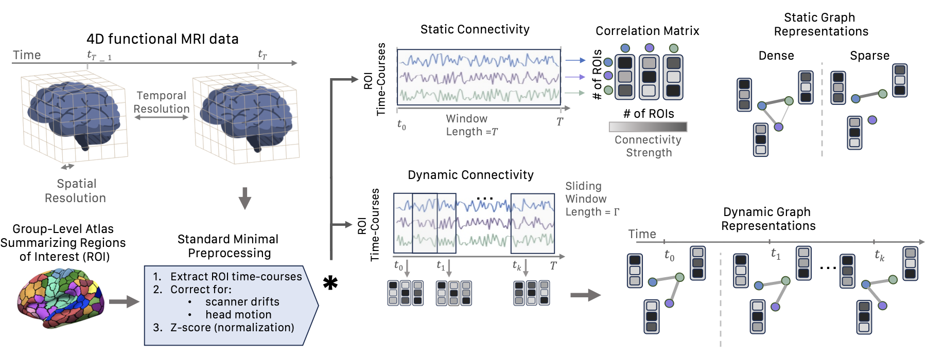
NeuroGraph: Preprocessing Pipeline

Slide 7
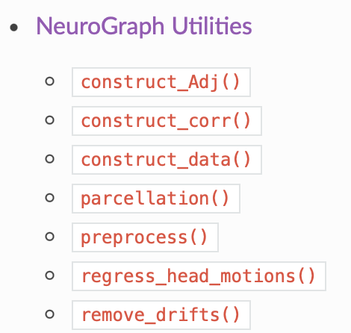
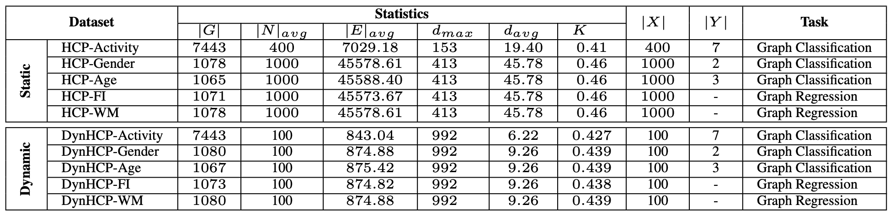
Tools and Benchmarks
Parcellation
Remove drifts
Remove head motions
Correlation matrices
Create graphs
Classes for constructing graph-based brain datasets

Slide 8
Mapping NeuroGraph to CWL
Describe and execute models in a standardized and transparent manner
Preprocess data with a single command
Easy to extend or update according to specific requirements
Easily train and save models
Perform inference with a single command
Achieve reproducible results through FAIR methods
Interoperability: compatible across multiple flatforms

Slide 9

CWL Workflows
Three step solution:
fMRI preprocessing workflow
Training workflow
Testing workflow

Slide 10
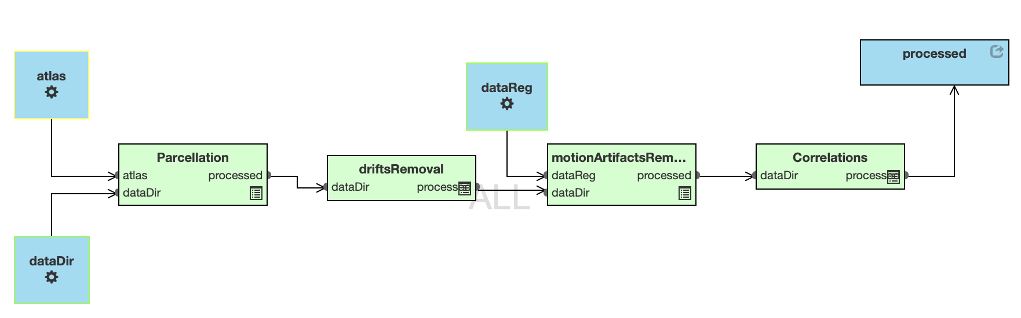
Preprocessing Workflow
INPUTS:
- A directory of fMRI images in “.nii.gz” format
- Atlas in “nii.gz” format
OUTPUT:
- A directory of correlation matrices in “.npy” format

Slide 11
fMRI preprocessing Steps
Parcellation
Divide the brain into distinct regions based on anatomical or functional characteristics
Provides a foundation for studying connectivity patterns
Remove Drifts
Removing low-frequency trends from the image
Detrending with quadratic polynomial function is used
Remove motion artifact
Regress out six rigid-body head motions parameters along with their derivatives
Compute correlation matrix

Slide 12
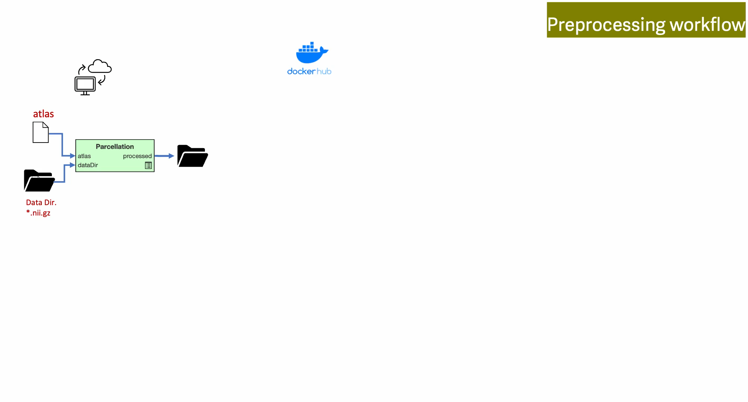

Slide 13
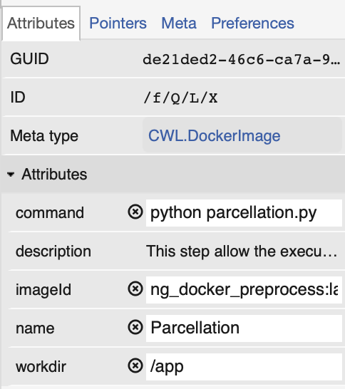
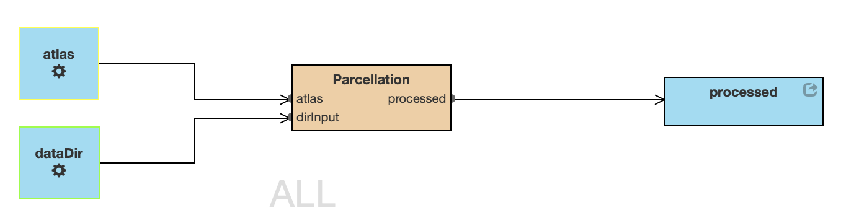
Parcellation
INPUTS:
- A directory of fMRI images in “.nii.gz” format
- Atlas in “nii.gz” format
OUTPUT:
- A directory of parcellated matrices in “.npy” format

Slide 14
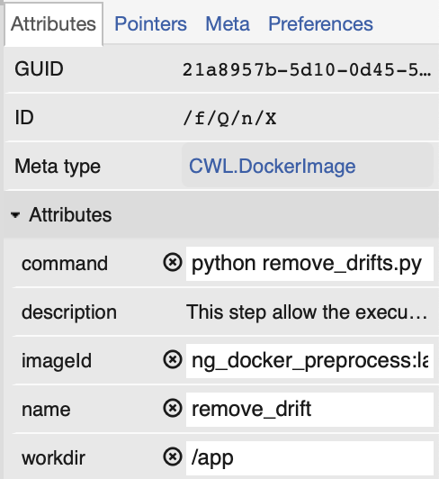
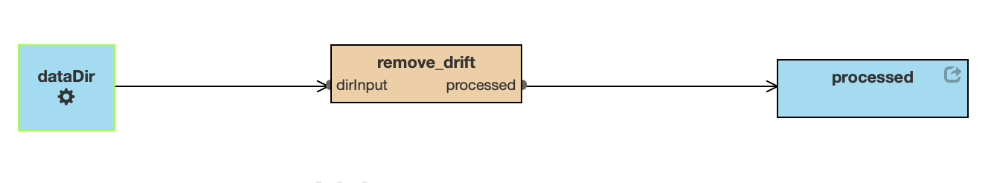
Remove Drift
INPUT:
- A directory of parcellated matrices in “.npy” format
OUTPUT:
- A directory of processed matrices in “.npy” format

Slide 15
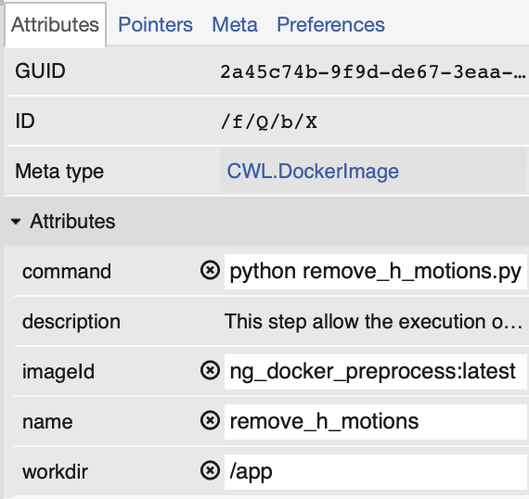
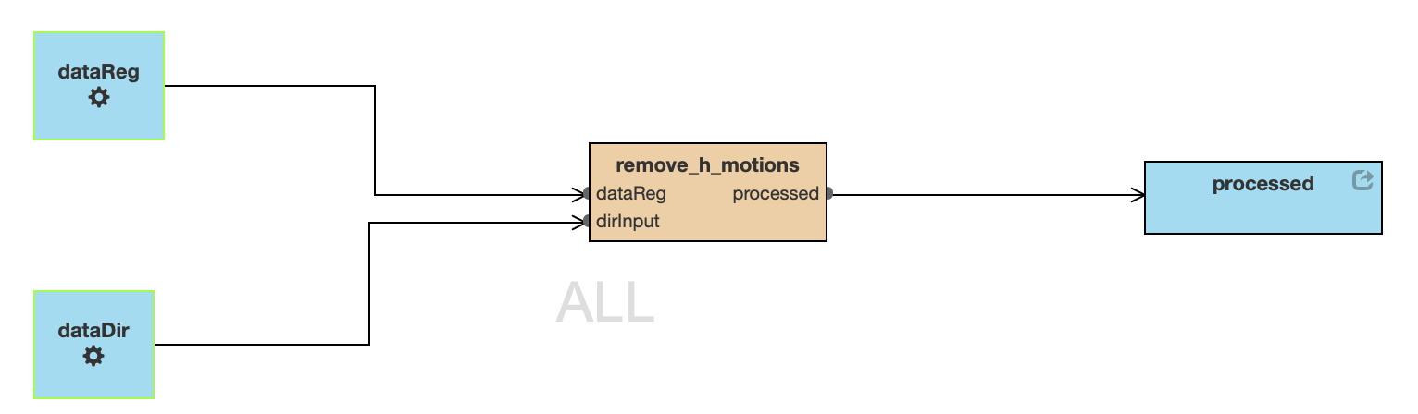
Remove Motion Artifacts
INPUTS:
- A directory of processed matr. in “.npy” format
- A directory of mov. regressors in “.txt” format
OUTPUT:
- A directory of processed matrices in “.npy” format

Slide 16
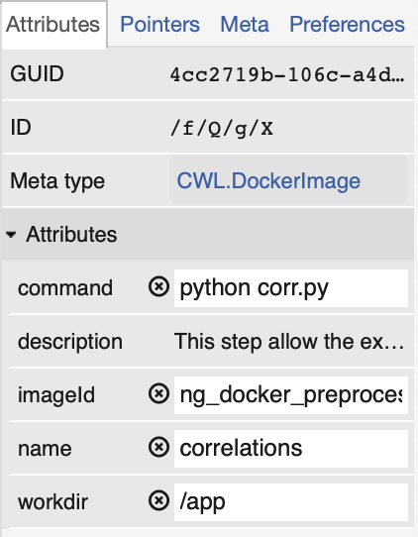
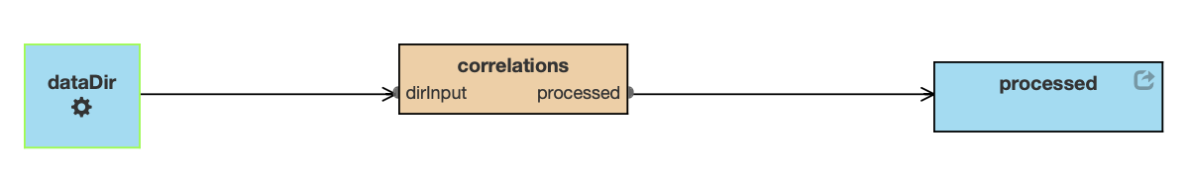
Constructing Correlations
INPUT:
- A directory of processed matrices in “.npy” format
OUTPUT:
- A directory of correlation matrices in “.npy” format

Slide 17
Running The Workflow
cwltool --no-match-user --no-read-only --tmpdir $PWD --preserve-environment LEAP_CLI_DIR fMRI_preprocess.cwl.json --dataReg data/raw --dataDir data/raw --atlas data/atlas.nii.gz

Slide 18
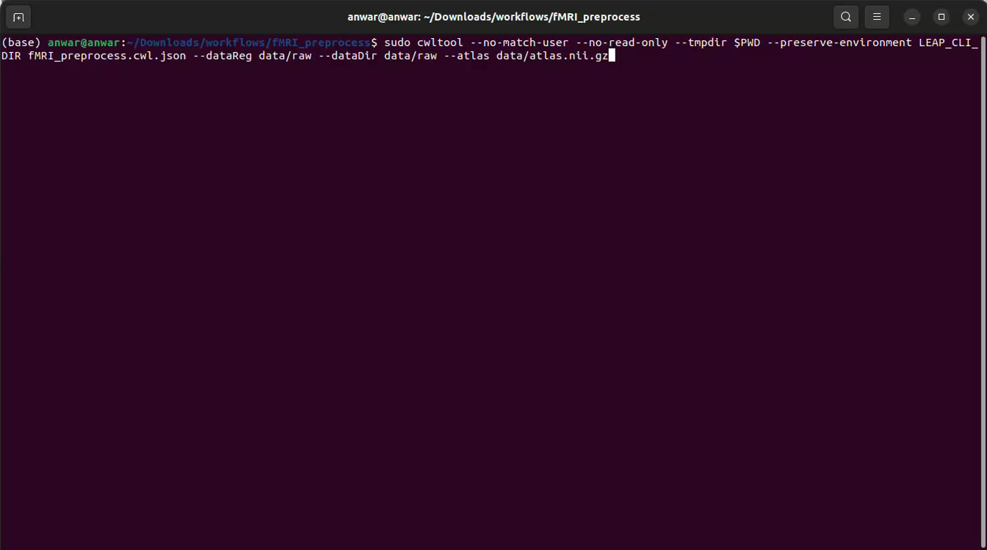
Demo

Slide 19
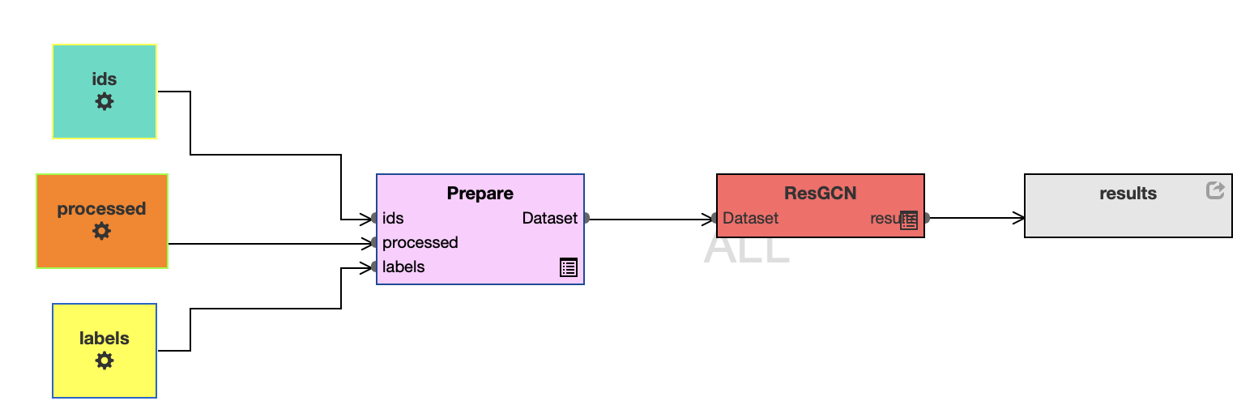
Training Graph Neural Networks
INPUT:
- A directory of corr. matrices in “.npy” format
- Labels associated with each subject (HCP)
- ids for mapping labels and correlation matrices
OUTPUT:
- A csv file containing accuracy

Slide 20
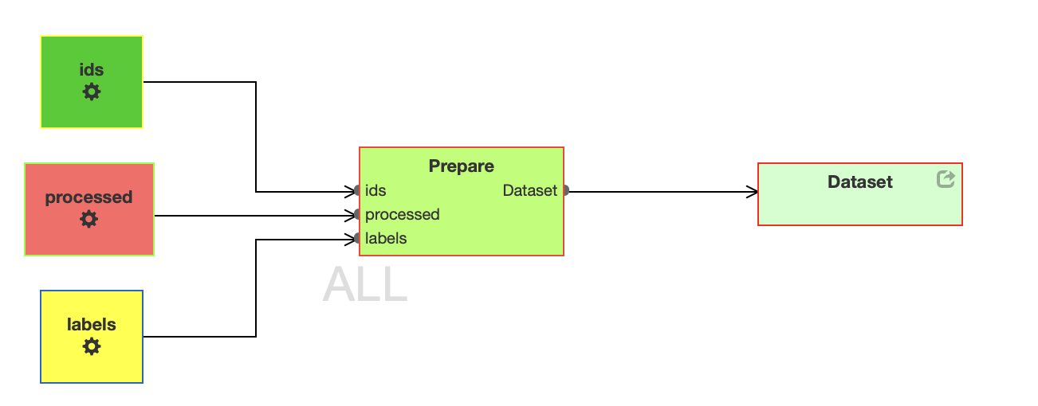
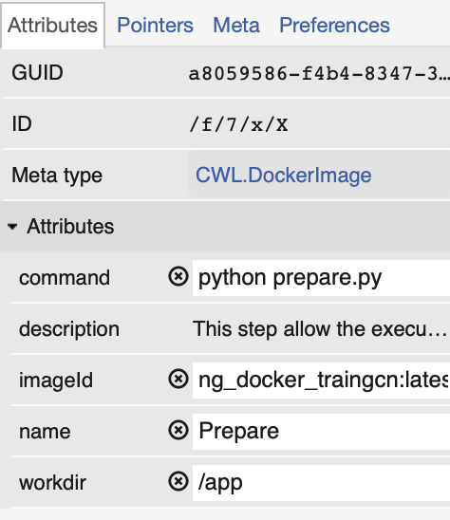
Prepare Workflow
INPUT:
- A directory of corr. matrices in “.npy” format
- Labels associated with each subject (HCP)
- ids for mapping labels and correlation matrices
OUTPUT:
- A graph dataset in “.pt” format

Slide 21
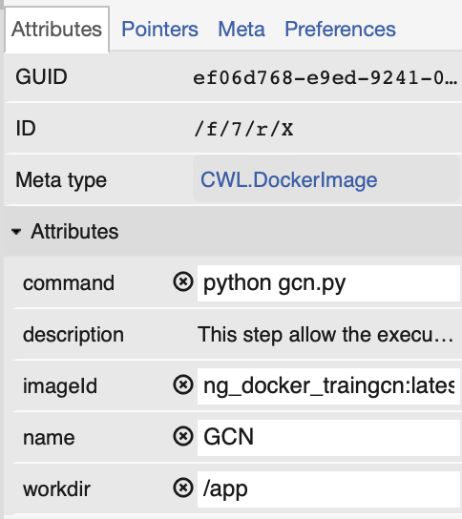
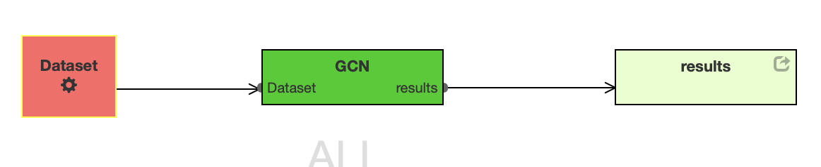
Train Workflow
INPUT:
- A dataset in graph format
OUTPUT:
- A csv file

Slide 22
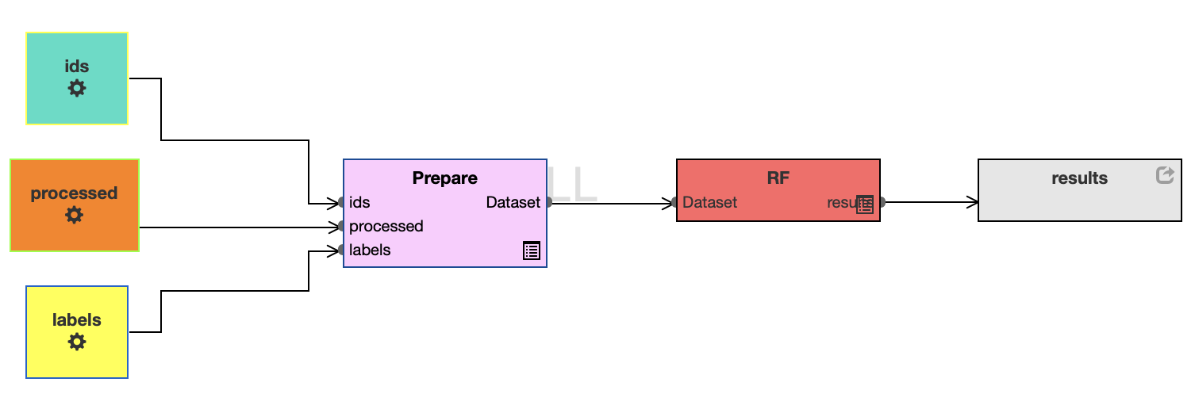
Train Random Forest
INPUT:
- A directory of corr. matrices in “.npy” format
- Labels associated with each subject (HCP)
- ids for mapping labels and correlation matrices
OUTPUT:
- A csv file

Slide 23
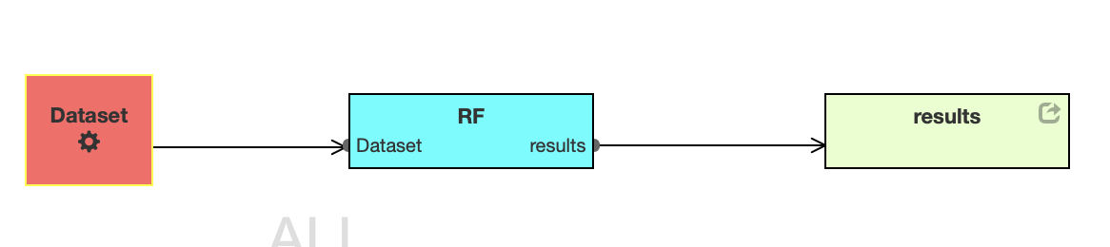
Train Workflow
INPUT:
- A dataset in “.pd” format
OUTPUT:
- A csv file

Slide 24
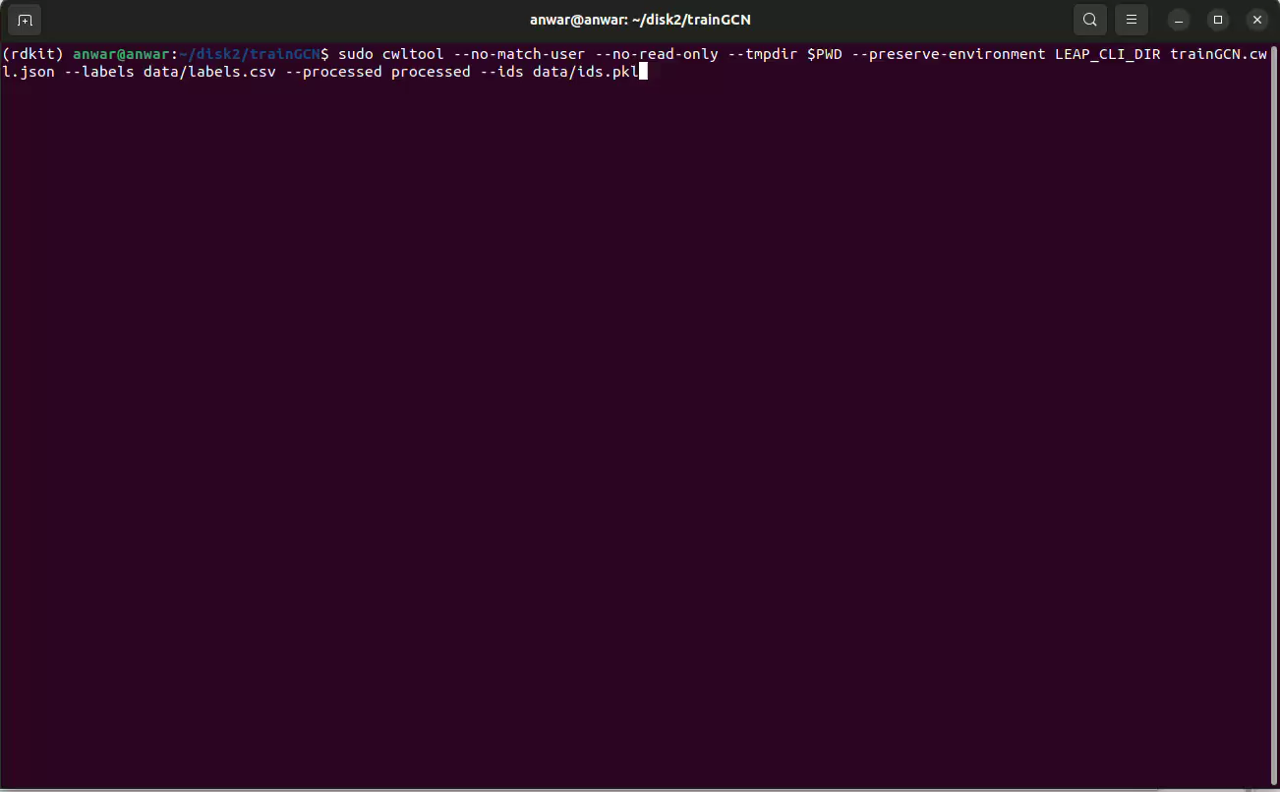
Demo

Slide 25
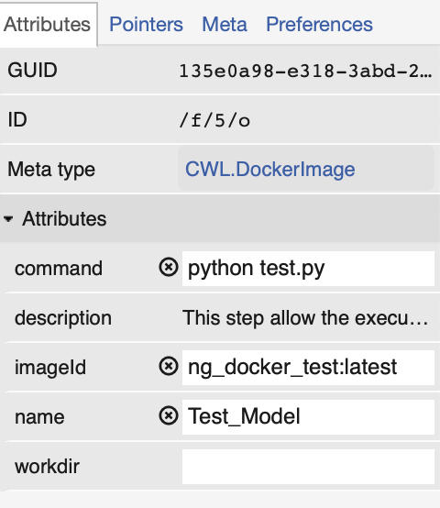
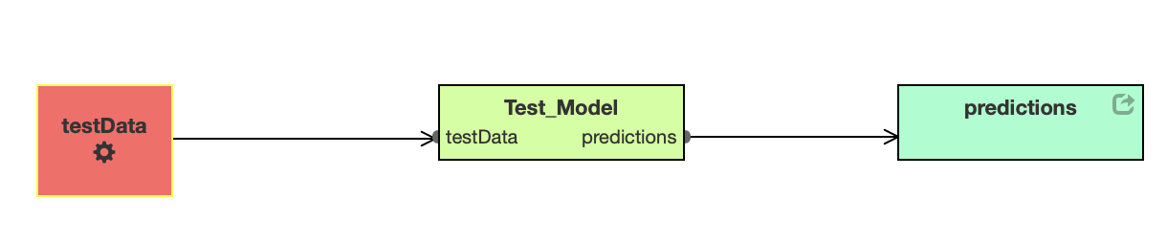
Test Model
INPUT:
- A graph or feature matrix
OUTPUT:
- A csv file containing predictions

Slide 26
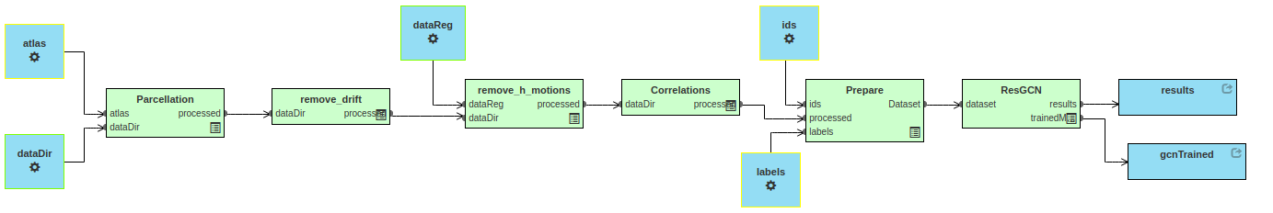
End-to-End Workflow
INPUT:
- A directory of fMRI images and mov. reg. in “.nii.gz”
- Atlas file in ”.nii.gz” format
- Labels associated with each subject (HCP)
- ids for mapping labels and correlation matrices
OUTPUT:
- A csv file
- A trained model in “.pkl” format

Slide 27
Resources
GitHub: https://github.com/Anwar-Said/NeuroGraphCWL
NeuroGraph Documentation: https://neurograph.readthedocs.io/en/latest/
Paper: https://arxiv.org/abs/2306.06202
We are currently working on additional improvements and will make the documentation available soon
Thank You

